Slide 1


Career Aspirations of Gen-Z – Insights & Key Findings
Presented By: Rakesh S Role: Data Analyst Intern
LinkedIn URL: Rakesh S

Slide 2

Agenda
1. Introduction
Project Overview
Objectives
2. Survey & Dataset
Design and Demographics
Key Attributes
3. Insights & Analysis
Learning Aspirations
Manager Aspirations
Mission Aspirations
4. Key Findings
5. Conclusion
6. Recommendations

Slide 3

Introduction
Project Overview:
The "Career Aspirations of Gen Z" project dives into understanding the aspirations, motivations, and preferences of Gen Z in the professional landscape. By leveraging survey data collected by KultureHire, this study explores key areas such as:
Learning preferences and aspirations for higher education.
Ideal qualities in managers and leadership styles.
Alignment with organizational missions and its impact on engagement.
This project provides actionable insights to help organizations attract, retain, and empower the next generation of talent while aligning with their evolving expectations.

Slide 4

Introduction
Objectives:
Identify Learning Aspirations: Understand Gen Z’s preferred learning modes, influencing factors, and higher education goals.
Explore Leadership Preferences: Highlight the managerial qualities Gen Z values for an optimal work environment.
Examine Mission Alignment: Assess the importance of mission clarity in driving employee satisfaction and engagement.
Deliver Actionable Insights: Provide recommendations to help businesses adapt their strategies to Gen Z’s career expectations.

Slide 5


Survey & Dataset
Design and Demographics:
The survey was designed to capture diverse insights from Gen Z professionals across different demographics and geographic locations. It was structured to include both qualitative and quantitative responses, focusing on understanding their aspirations, preferences, and motivations.
Respondent Demographics:
Geography: The majority of responses were from India.
Gender: Included a balanced representation of male, female, and other genders, ensuring inclusivity.
Age Group: Targeted primarily at Gen Z individuals (18–26 years).
This design ensures a robust representation of the Gen Z cohort, providing a reliable foundation for actionable insights.

Slide 6

Survey & Dataset
Key Attributes:
The dataset consists of 124,708 rows, with a variety of columns that captured crucial aspects, including:
Career Preferences: Top career choices and influencing factors.
Learning Aspirations: Preferred learning environments, aspirations for higher education, and key influences.
Managerial Expectations: Qualities desired in ideal managers and leadership preferences.
Mission Alignment: The role of organizational mission clarity in fostering employee satisfaction.
Workplace Trends: Willingness to work under challenging circumstances, remote work preferences, and tenure expectations.
This rich dataset enabled detailed analysis to uncover Gen Z’s career aspirations and workplace expectations.

Slide 7
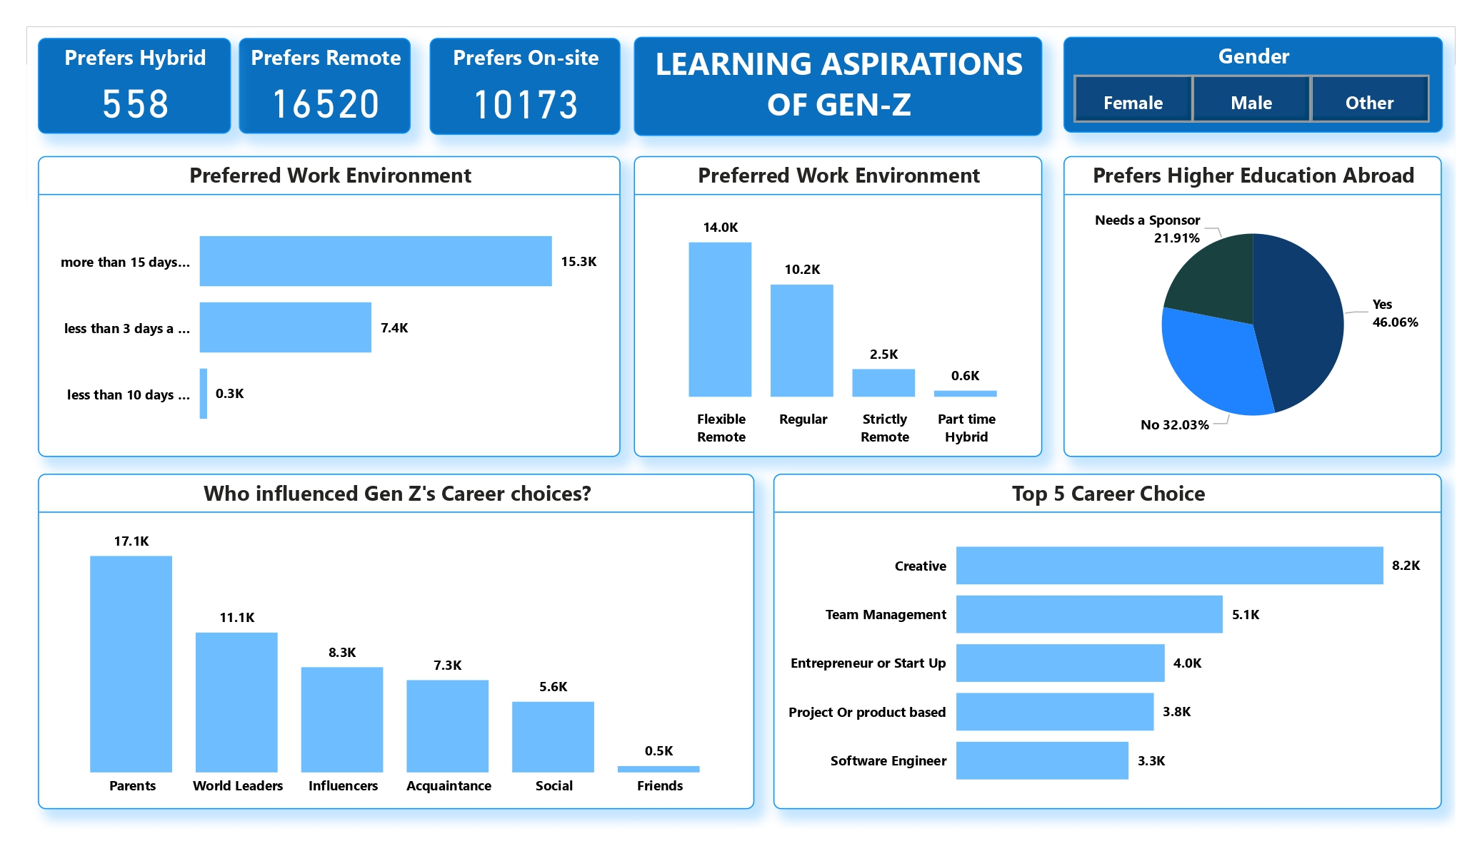
Insights & Analysis

Slide 8
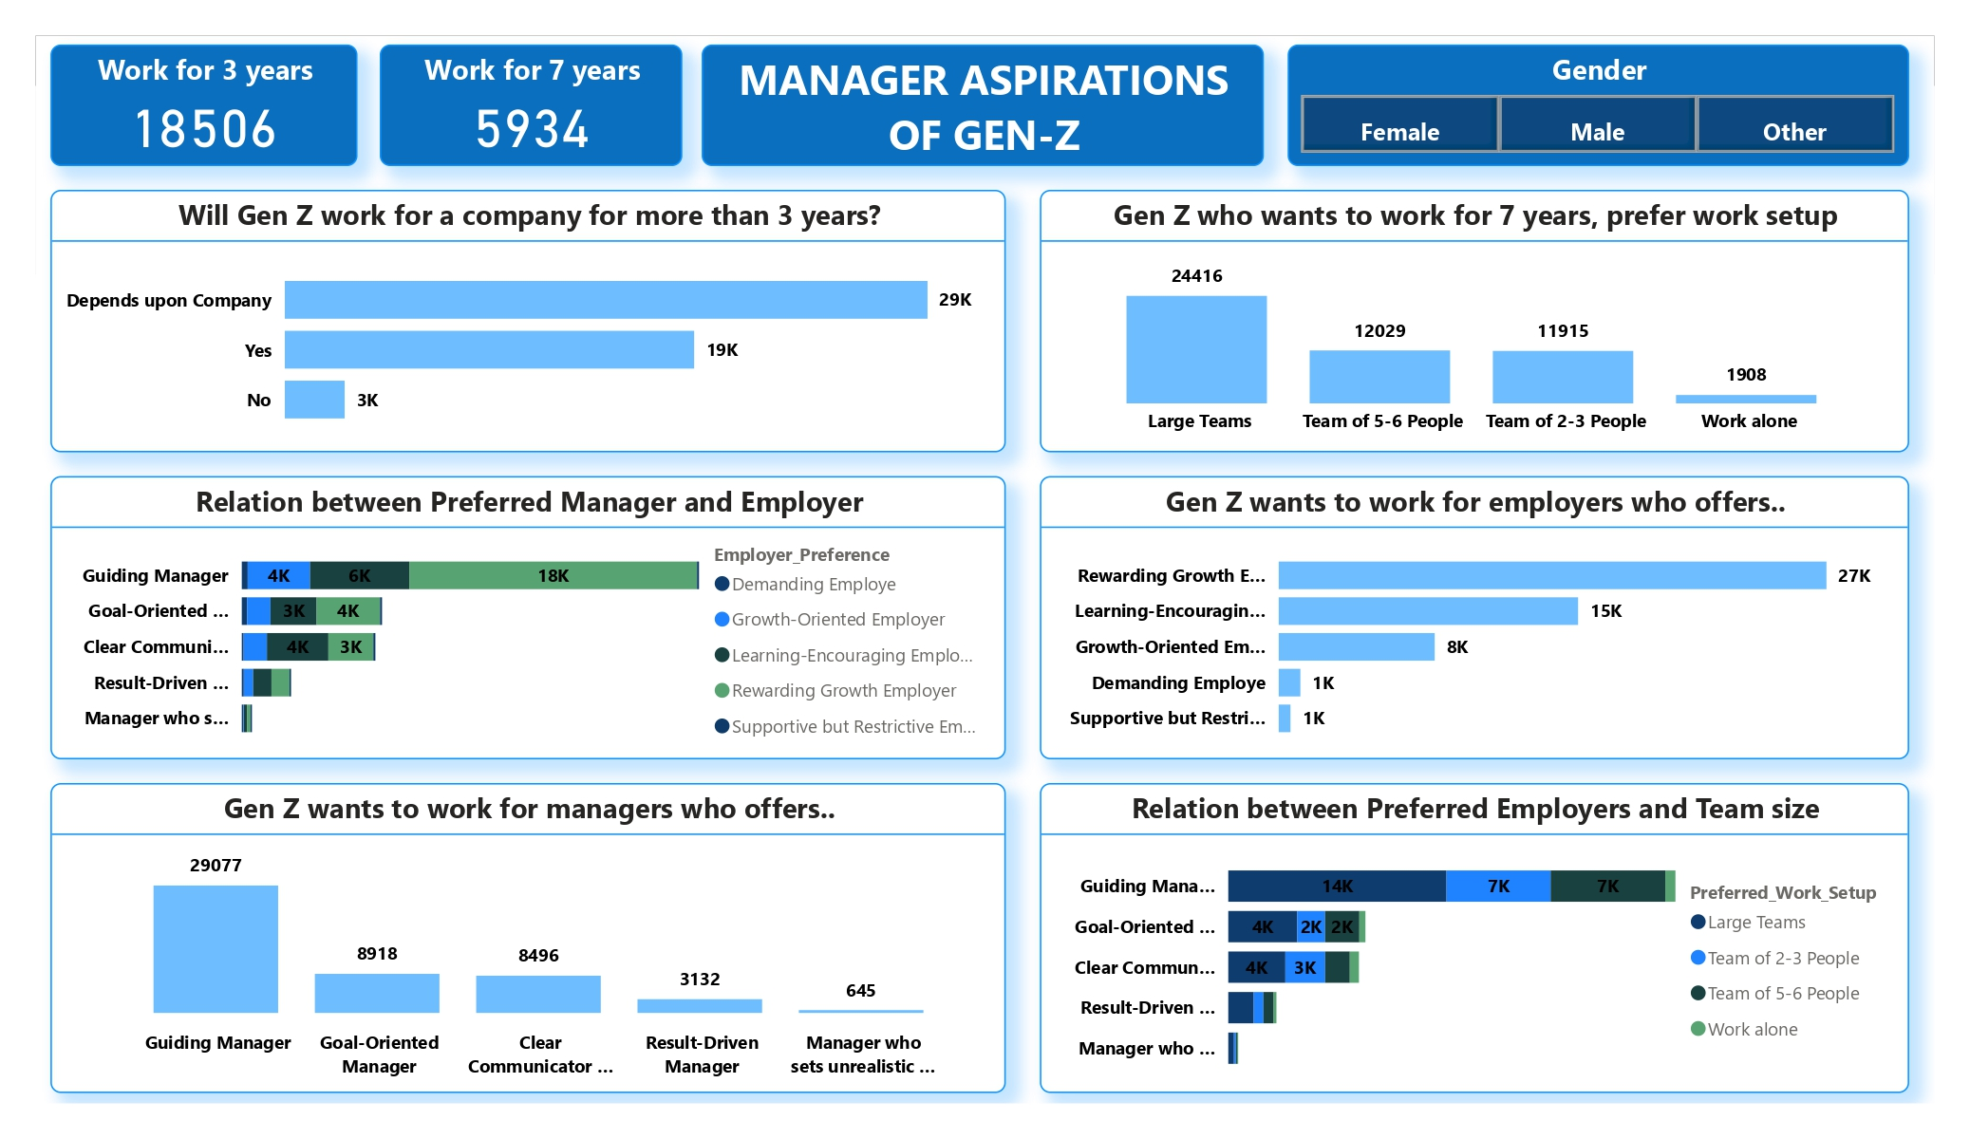
Insights & Analysis

Slide 9
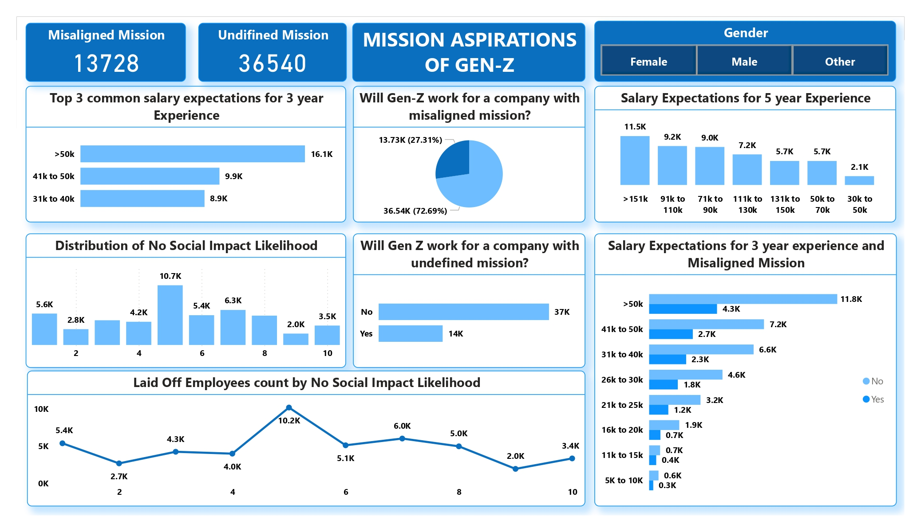
Insights & Analysis

Slide 10
Key Findings
The analysis of Gen Z’s career aspirations and workplace expectations revealed several important trends:
Learning Aspirations:
A strong preference for structured yet flexible learning environments, with Expert-Led Programs as the top choice.
46.06% aspire to higher education, but affordability remains a key concern for a significant portion.
Career Preferences:
Gen Z is drawn to creative, analytical, and management-focused roles, with Design & Strategy, Data Analytics, and Business Operations dominating career choices.
Traditional industries like Cybersecurity, BPO Services, and Sales & Marketing are less favored.
Managerial Expectations:
Employees value managers who provide clear goals, supportive leadership, and transparency, emphasizing the need for structured leadership practices.
Mission Alignment:
Misaligned missions lead to frustrations like unclear goals and lack of transparency, highlighting the critical importance of organizational clarity.
Workplace Trends:
The majority are open to long-term tenure when organizations prioritize mission alignment and transparency, demonstrating resilience and adaptability.
These findings offer valuable insights into Gen Z’s priorities, enabling organizations to align their strategies for attracting and retaining young talent effectively.

Slide 11
Conclusion
The analysis of Gen Z's career aspirations and workplace expectations highlights the generation's focus on structured learning, supportive leadership, and mission-driven work environments. Gen Z seeks careers that blend creativity, analytical thinking, and management while prioritizing transparency and alignment with organizational goals. Their resilience and adaptability are evident, but factors like affordability, clarity, and trust significantly influence their decisions regarding education and employment. These insights can guide organizations in tailoring strategies to attract and retain this dynamic workforce.

Slide 12
Recommendations
Foster Transparent Leadership:
Cultivate clear communication channels and set well-defined goals to enhance employee trust and satisfaction.
Invest in Learning Opportunities:
Offer expert-led programs, self-paced learning, and observation-based training to meet Gen Z’s diverse learning preferences.
Support Higher Education Aspirations:
Provide sponsorships or education assistance programs to address affordability concerns and encourage skill development.
Align Organizational Mission:
Ensure the company’s mission aligns with employees’ values to reduce frustrations and foster loyalty.
Create Rewarding Work Environments:
Balance high-pressure tasks with meaningful rewards and learning-focused support to drive engagement and professional growth.
By implementing these strategies, organizations can establish themselves as employers of choice, effectively meeting the aspirations and expectations of Gen Z talent.

Slide 13


